Slide 1
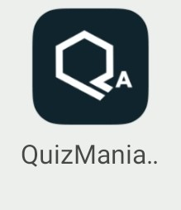
QUIZMANIA ADMIN
Icon of the app

Slide 2
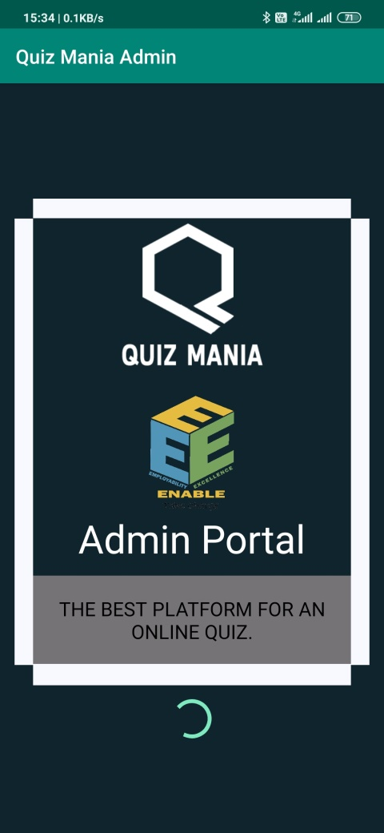
Welcome Page
This is the welcome screen which appears as the Application gets started.

Slide 3
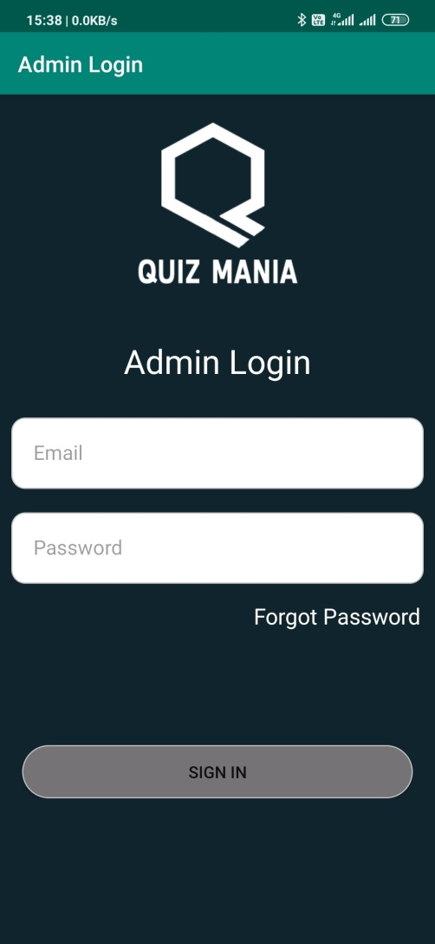
Admin Login Page
This page allows the Admin to login.
Only existing Admins are allowed to log in through this page.

Slide 4
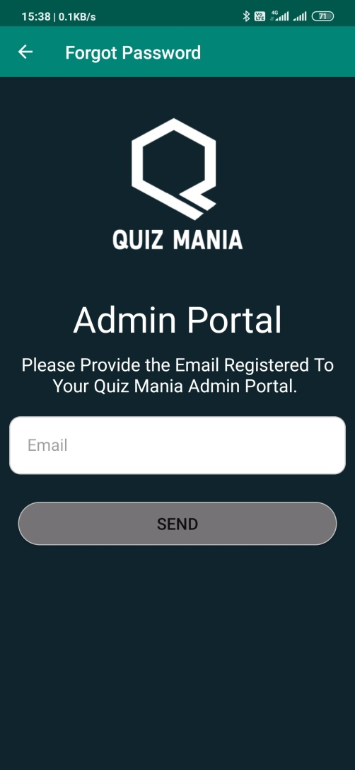
Forgot Password
This page allows the admin to recover the password by the link shared on the E-Mail stored in the Database.

Slide 5
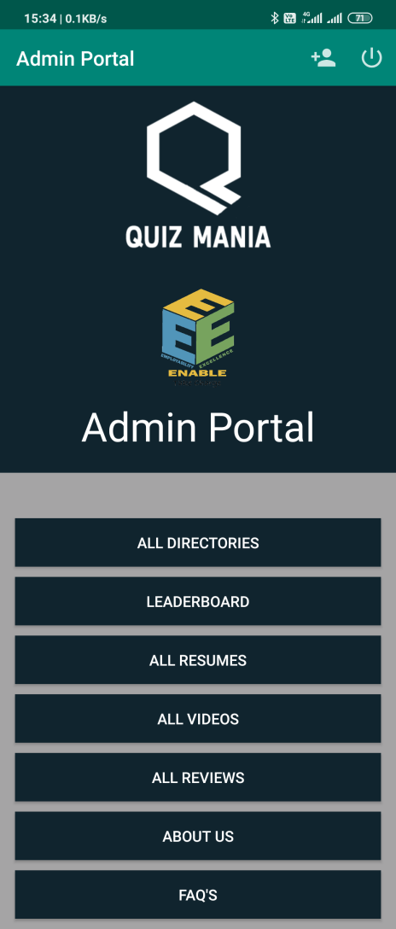
Main Page
This is the first page of the Application which appears after the admin gets logged in.

Slide 6
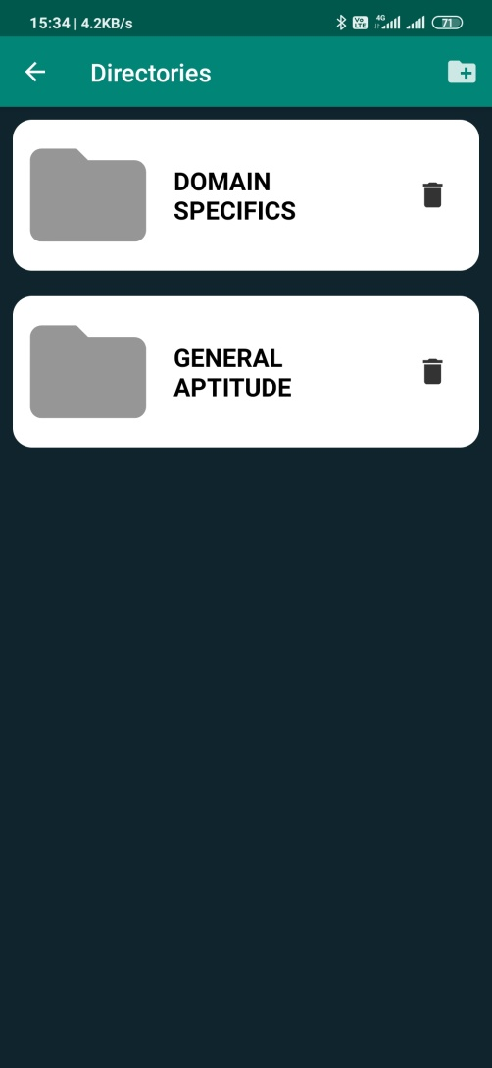
Directories
This page appears when the Admin click on the All Directories option.
Admin can Add a new directory or Delete an existing directory by the given options.
Admin can get into a directory by clicking on it.

Slide 7
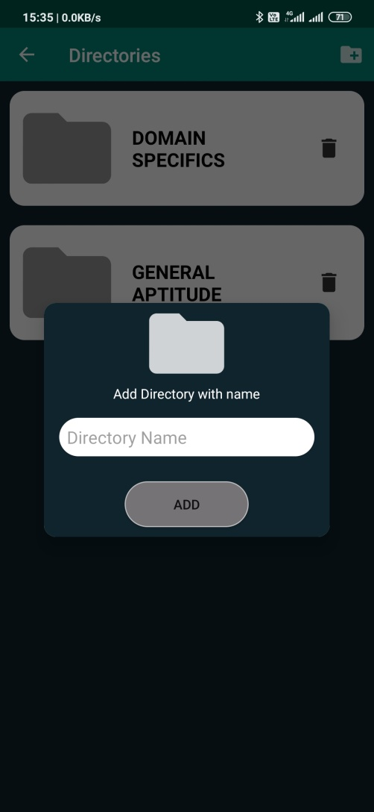
Add Directory
This page allows the Admin to add a new directory by clicking on the add directory button present at the top right corner.
Admin can add a new directory with a preferred name.

Slide 8
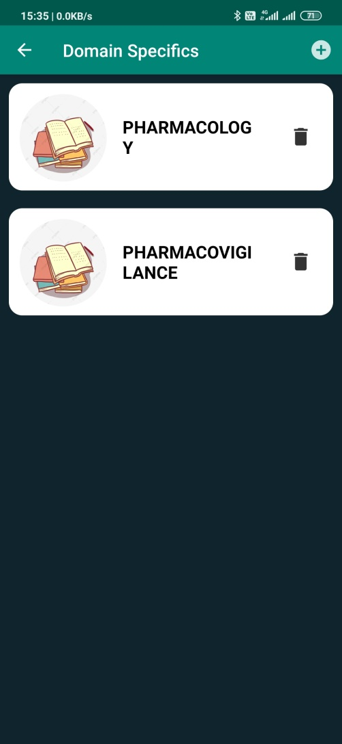
Inside Directory
This page is displayed when the Admin gets inside the directory.
It specifies the Topics which are added inside the directory.
The topics can also be deleted by clicking on that delete button.

Slide 9
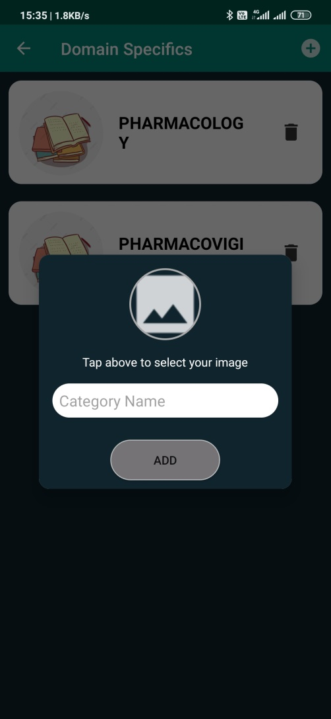
Add New Topic
This option helps the Admin to add a new topic by simply clicking on the plus button and adding a preferable name and image to that topic.

Slide 10
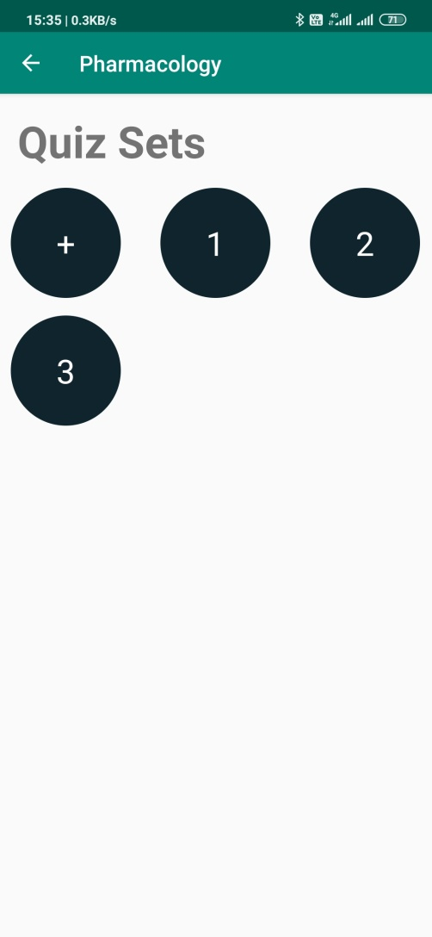
Quiz Set
On this page Admin can add, view and delete a quiz set.
Quiz can be added by clicking on the plus button.

Slide 11
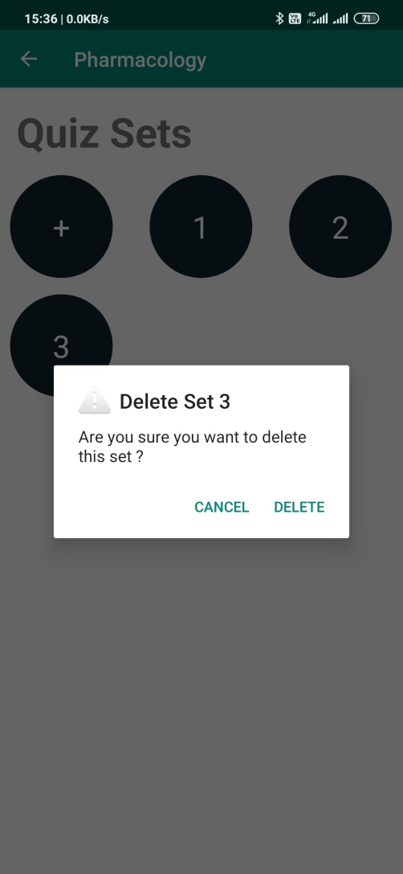
Delete Quiz
A quiz set can be deleted by holding the set button for a long time, and the a dialog will be displayed asking to delete that set.

Slide 12
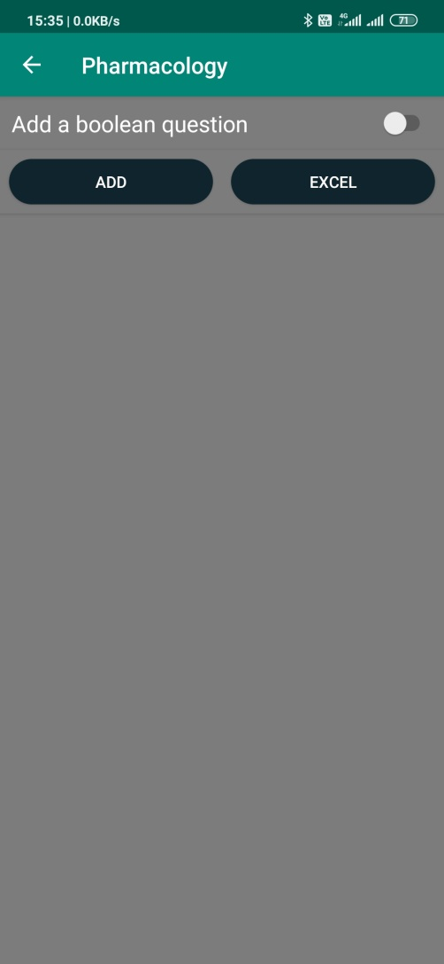
Adding Questions
On this page the Admin will be able to Add a question.
Question can be added in 3 ways,
1. By switching on the add Boolean question switch and clicking the add button to add a Boolean question.
It will have only 2 options.

Slide 13
Adding Questions cont.
2. By simply clicking on add button to add a 4 options question.
3. By clicking on excel button to add an Excel sheet of questions.

Slide 14
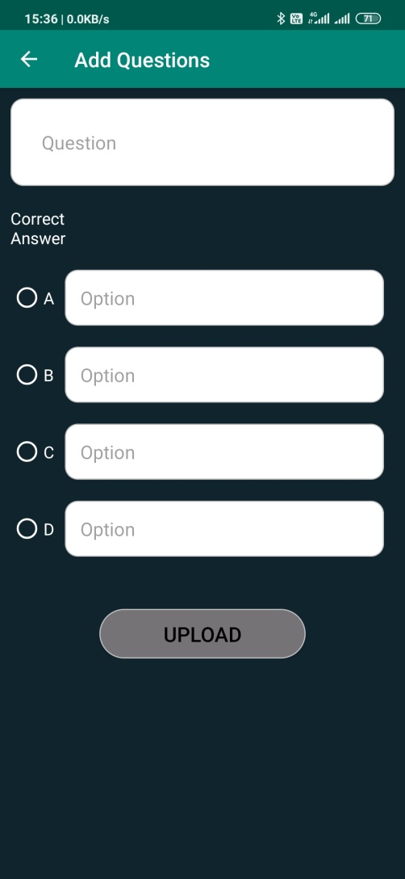
Add Question
This option is to add a single Multiple Choice Based Type question.
It can be done by simply clicking on the add question button.

Slide 15
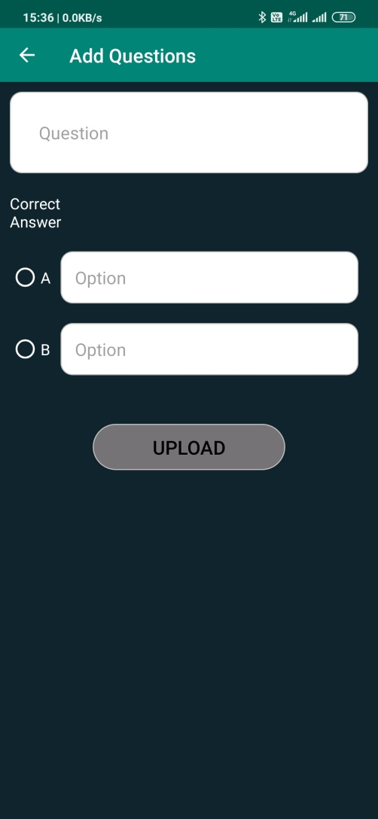
TRUE/FALSE Based Questions
This option can be used to add a true/false type of questions.
Admin can simply put a question with only two choices.

Slide 16
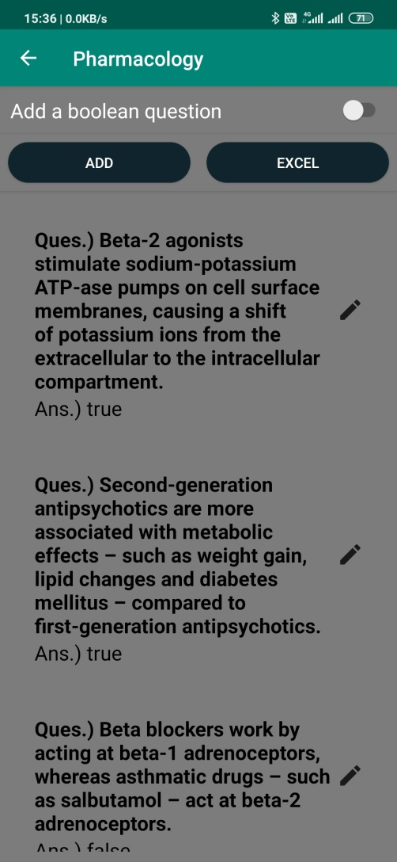
VIEW/EDIT Question
This page is displays all the questions in a particular set.
Admin can even edit or delete a question of his/her choice.

Slide 17
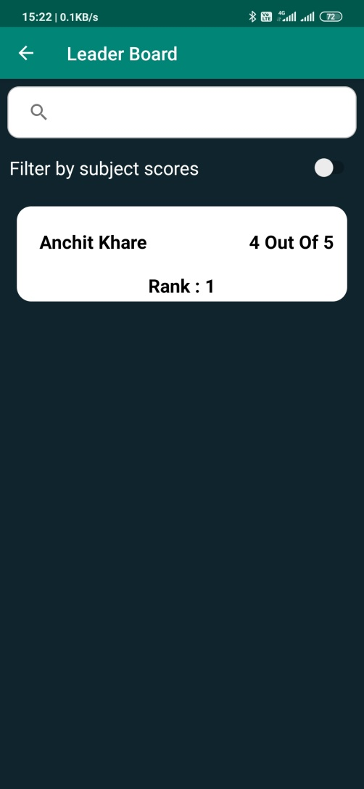
Leader Board
This page shows the overall leader board of the students.
The leader can be searched by his name.

Slide 18
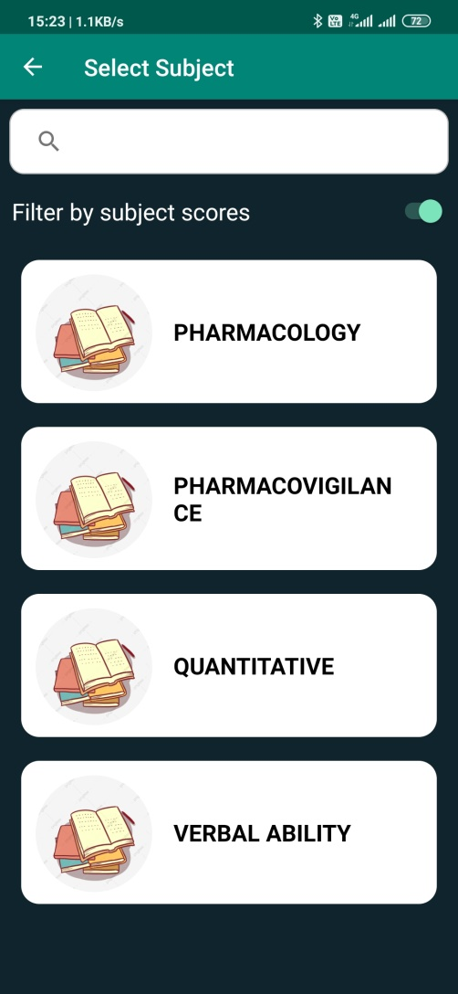
Leader Board
This is the subject leader board which allows the Admin to view the leaders of a particular subject or topic.

Slide 19
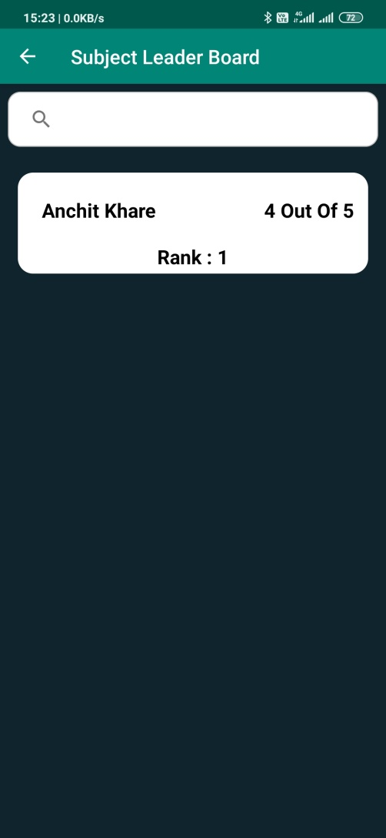
Leader Board cont.
This page appears when a Subject is selected.
It shows all the leaders of that particular subject.

Slide 20
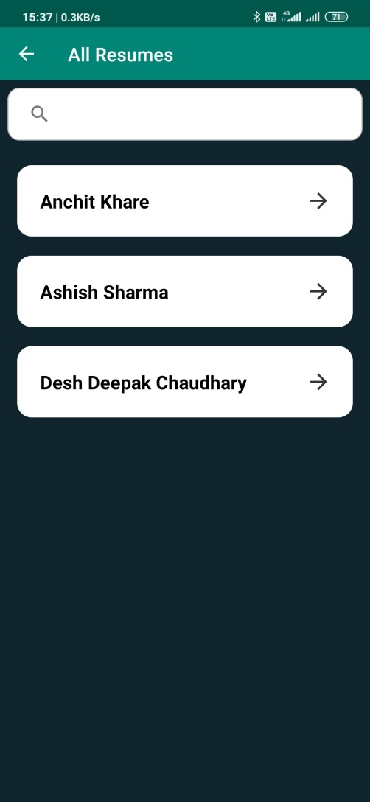
Resume
It shows the names of the people who have uploaded their resumes.
Resume can be seen by clicking on the names.

Slide 21
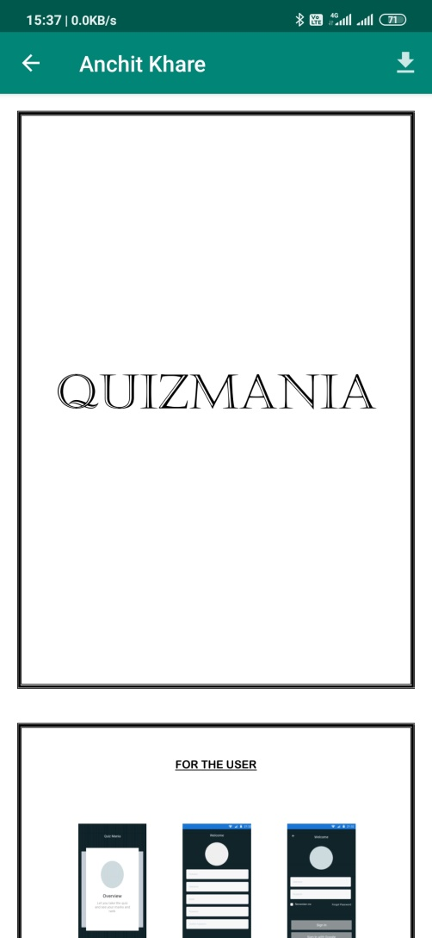
Resume
Application has an inbuilt Pdf viewer.
Resume can be viewed by clicking on them and can also be downloaded by clicking on the download button present at the top right corner.

Slide 22
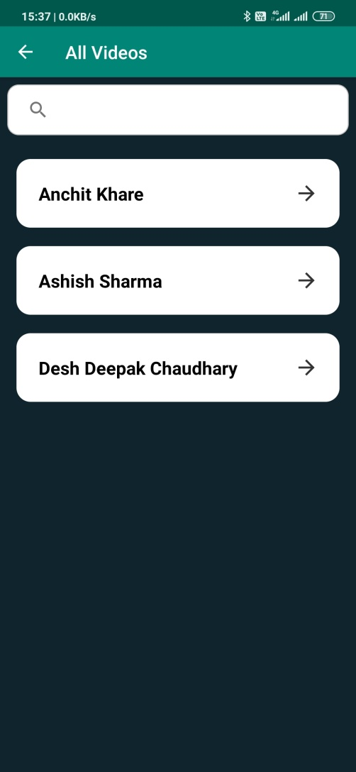
All Videos
This page shows the names of all the users who have uploaded their videos.
Videos can be seen by clicking on the names.

Slide 23
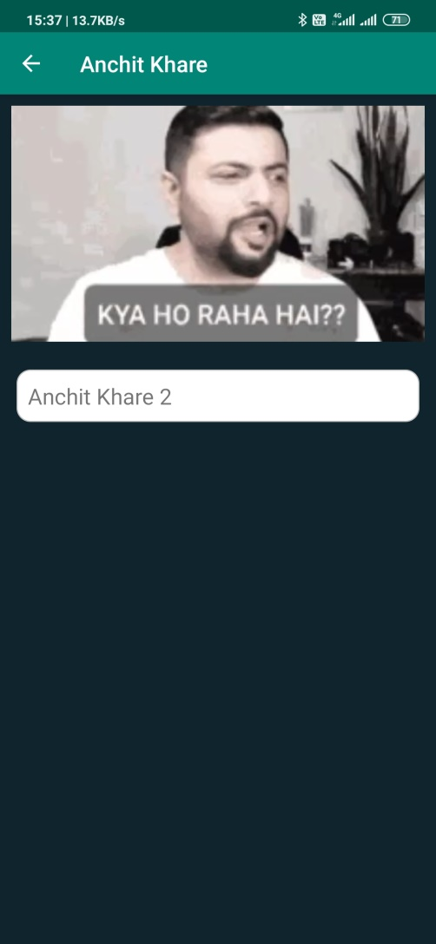
Video Viewer
This is the page where the admin can view the video with it’s video name of a particular user.

Slide 24
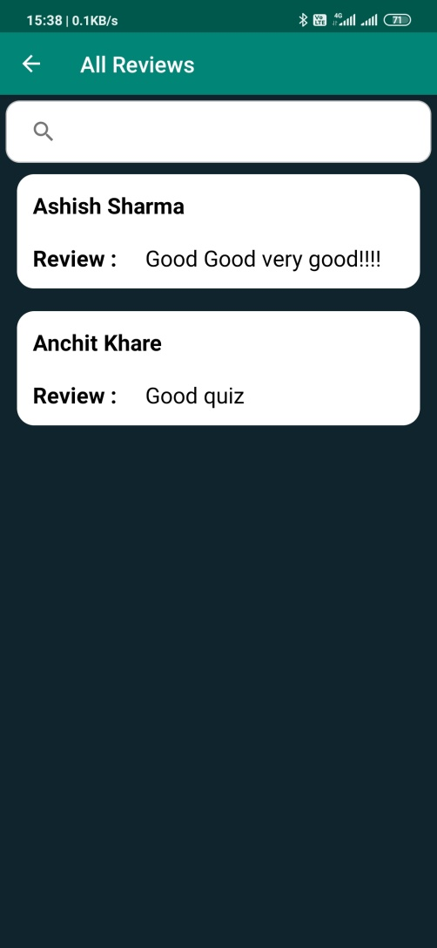
Reviews
This page displays all the reviews which are given by the users about the quizzes.

Slide 25

About Us
This is the about us page for the admin where he/she can find all the details about the company.

Slide 26
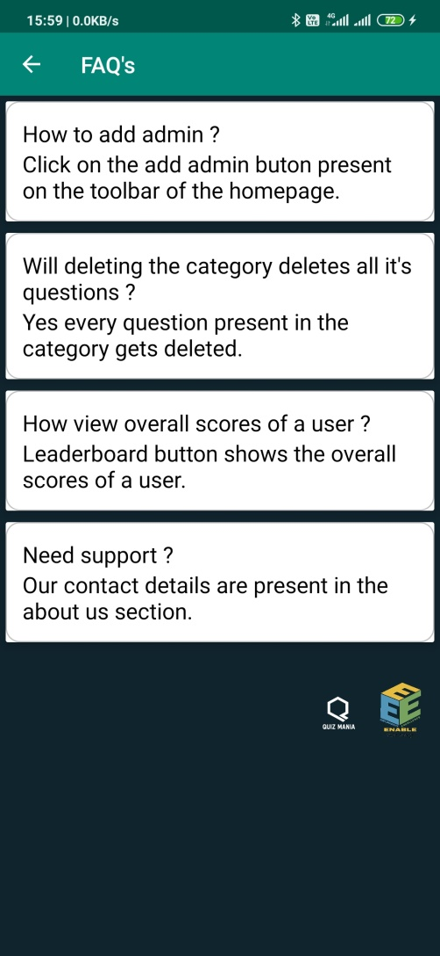
FAQ’s
This is the Frequently Asked Questions page where the admin can clear some of his/her doubts regarding the features of the app.

Slide 27
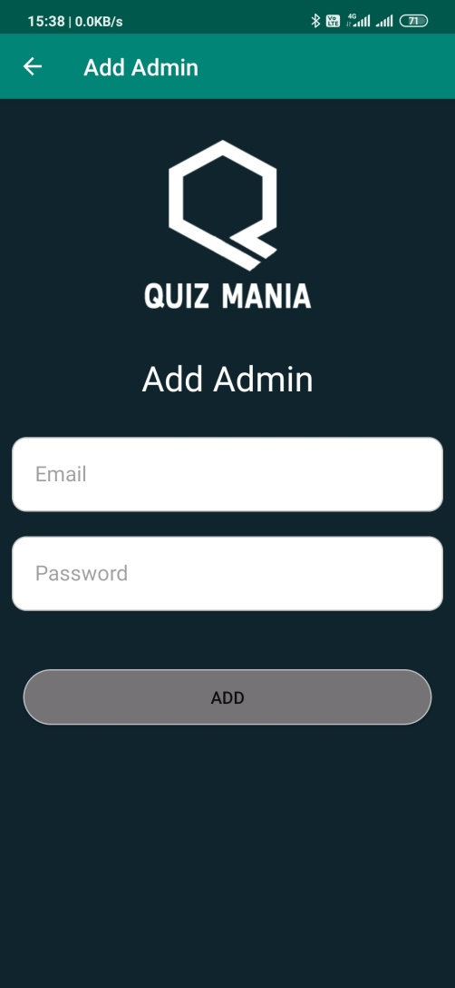
Add Admin
Admin can add another Admin by clicking on the Plus Button present at the top.
Admin can be added by providing a valid Email and a password and after verifying the email, the new admin can also login with the registered credentials.

Slide 28
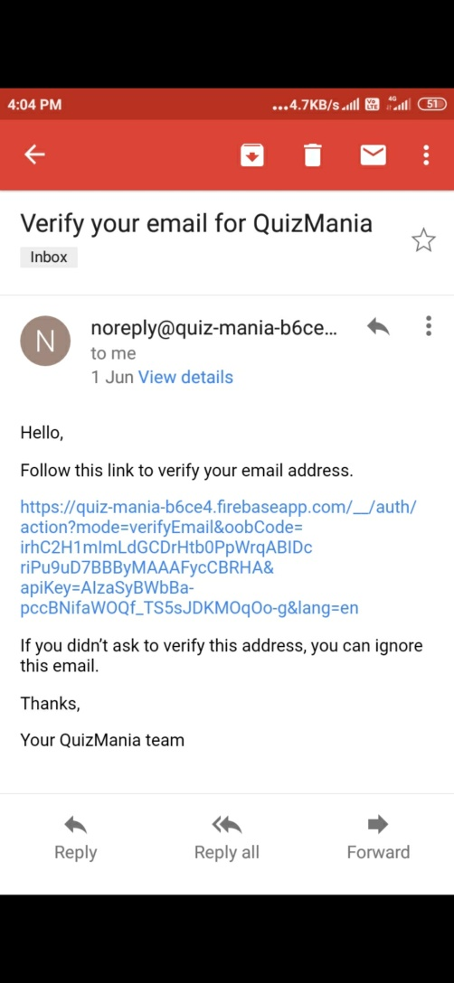
Verification E-Mail
This is the screenshot of the mail which is sent to the new admin at the registered email.
After verifying he/she can proceed further.

Slide 29
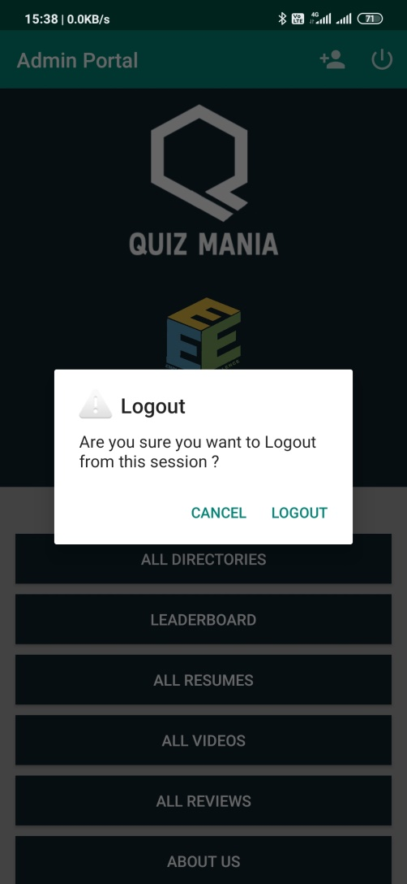
LOGOUT
Admin can logout of the application by simply clicking on the logout button present at the top right corner.

